Slide 1
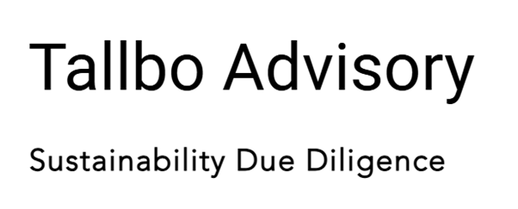
Due Diligence Instruction
Clarified obligations & scope
1
1
2
No clear due diligence process and roles
2
4
4
3
3
Defined roles & responsibilities
Designed practical process steps
5
5
6
6
Aligned with governance structure
Confidence to implement and monitor due diligence

