Slide 1
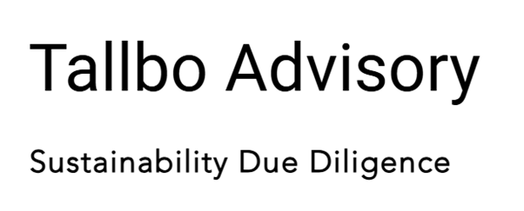
Responsible Sourcing Instruction
Defined responsible sourcing goals
1
Sourcing not aligned with values
1
2
2
4
4
3
3
Defined roles & responsibilities
Designed practical process steps
5
5
6
6
Aligned with governance structure
Stronger sourcing decisions & leverage

