Slide 1
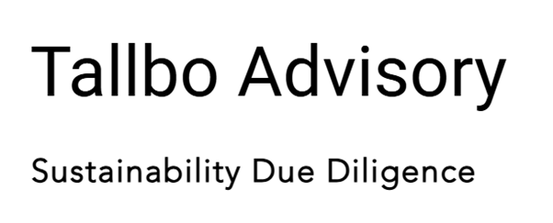
Responsible Sourcing Gap Analysis
Clarified what “responsible” means
1
1
2
Ad hoc or buyer driven sourcing practices
2
4
Identified gaps in supplier engagements
4
3
3
Reviewed risk assessments, supplier screenings & contract clauses
5
5
6
6
Built internal buy-in for improvements
Ready to embed responsible sourcing

