Slide 1
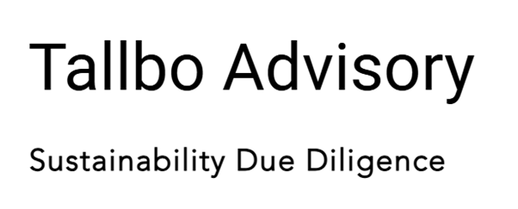
Policy Development
Agreed purpose and scope
1
1
2
2
No policy or outdated document
4
4
Internal & external feedback and revisions
3
3
Draft aligned with expectations
5
5
6
6
Approved and published policy
Credibility with stakeholders improved

